Slide 1
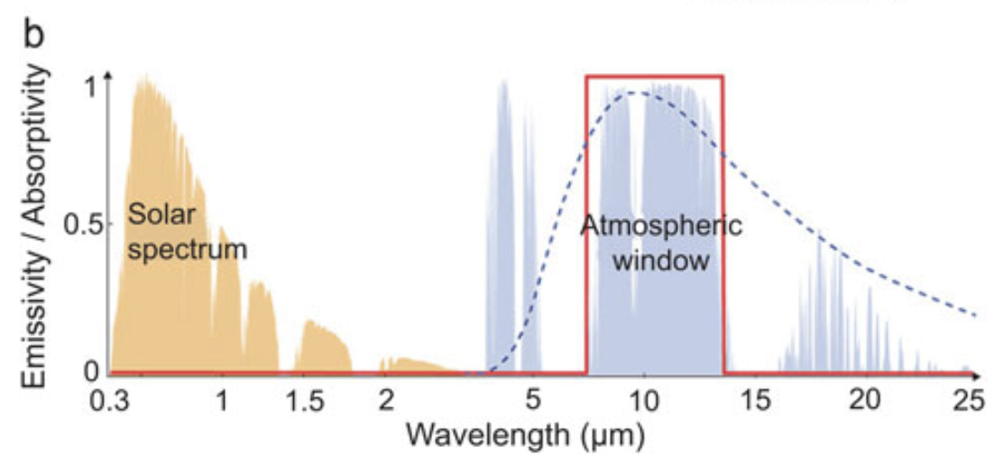
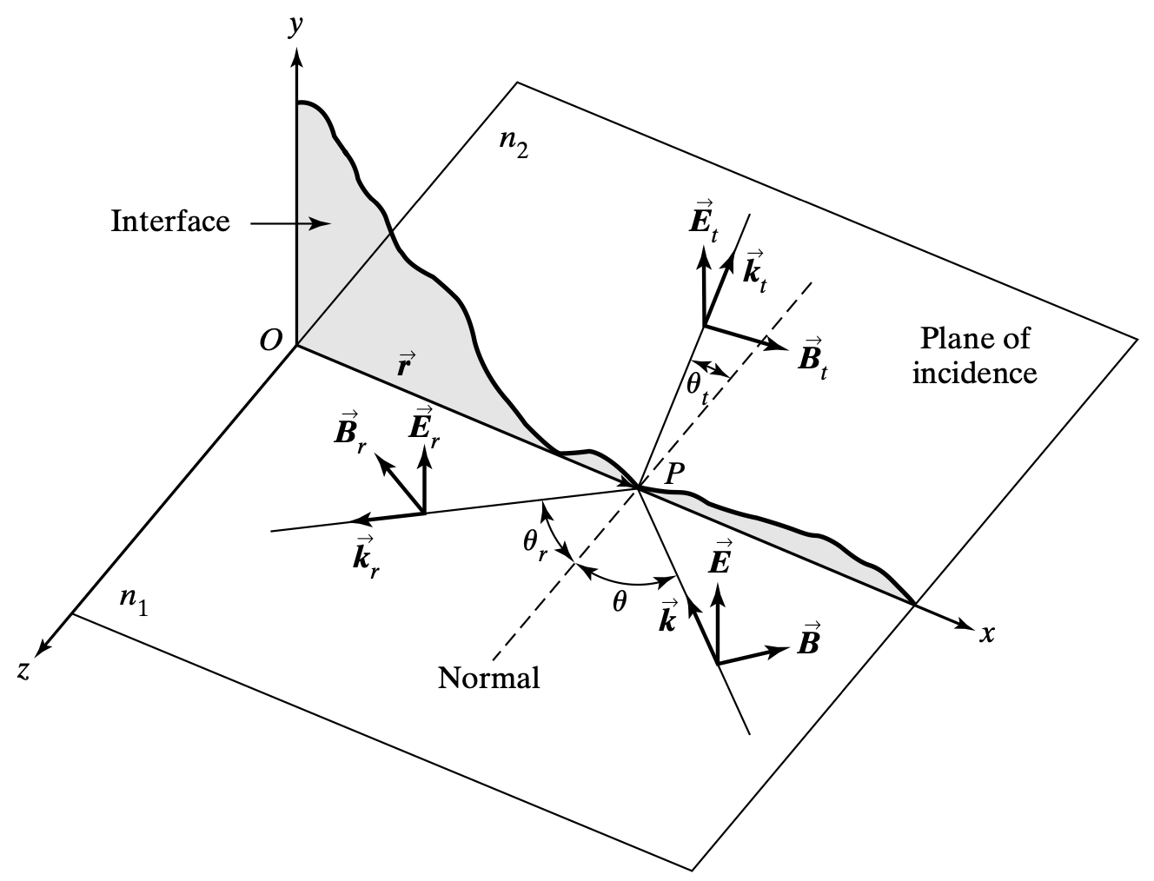
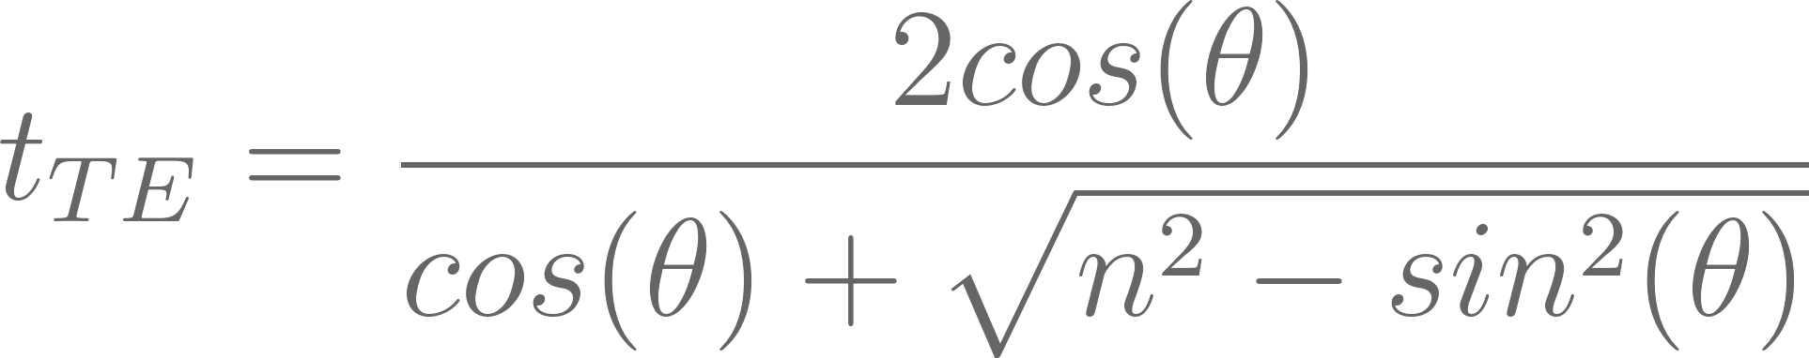
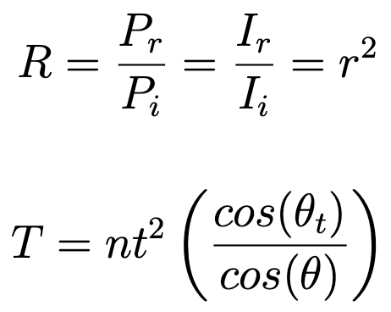
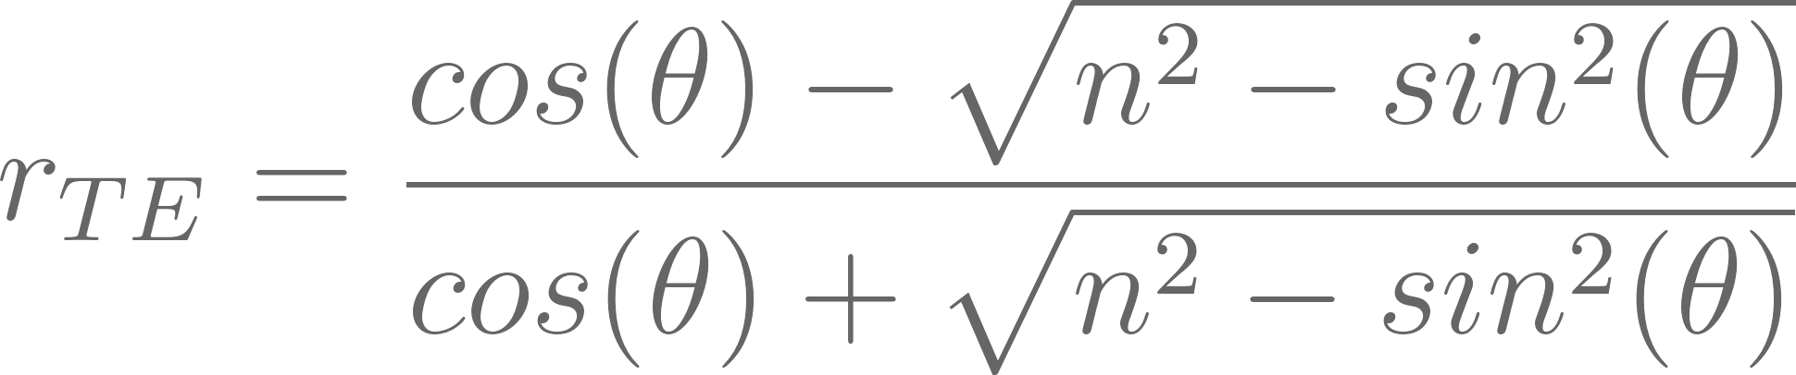
The physics behind pdrC DEVICES
Ideal optical properties of a radiative cooling device
Fresnel EQUATIONS - THEORY
A transverse electric polarization mode
Applies to any linear, isotropic, and homogeneous medium.
One half of the Fresnel Equations

